Slide 1
SUPPLY CHAIN ANALYSIS
By VISHWA SAGAR

Slide 2
Table of Contents
Introduction
Business Task
Data Overview
Data Story
Pitch
Call to Act

Slide 3
Introduction
Supply chain analytics is a valuable part of data-driven decision-making in various industries such as manufacturing, retail, healthcare, and logistics. It is the process of collecting, analyzing and interpreting data related to the movement of products and services from suppliers to customers.

Slide 4
Business Task
The main objective of this case study is to Analyze Product Performance and Supply Chain Efficiency. The objectives of the case study are given below:
Which product type generates the highest revenue?
Are there any significant correlations between lead times and order quantities?
How do shipping costs vary by shipping carrier and location?
Which suppliers have the most efficient manufacturing processes based on manufacturing lead time and production volumes?
What demographic group contributes the most to sales?

Slide 5
Data Overview
The dataset is collected from a Fashion and Beauty startup. The dataset is based on the supply chain of makeup products. Below are the features in the dataset:
Product Type
SKU(Stock Keeping Unit)
Price
Availability
Number of products sold
Revenue generated
Customer demographics
Stock levels
Lead Times

Slide 6
Data Overview (continued)
Order quantities
Shipping times
Shipping carriers
Shipping costs
Supplier name
Location
Lead time
Production volumes
Manufacturing lead time
Manufacturing costs, Defect rates, Transportation modes, Routes, and Costs.

Slide 7
DATA STORY ….

Slide 8
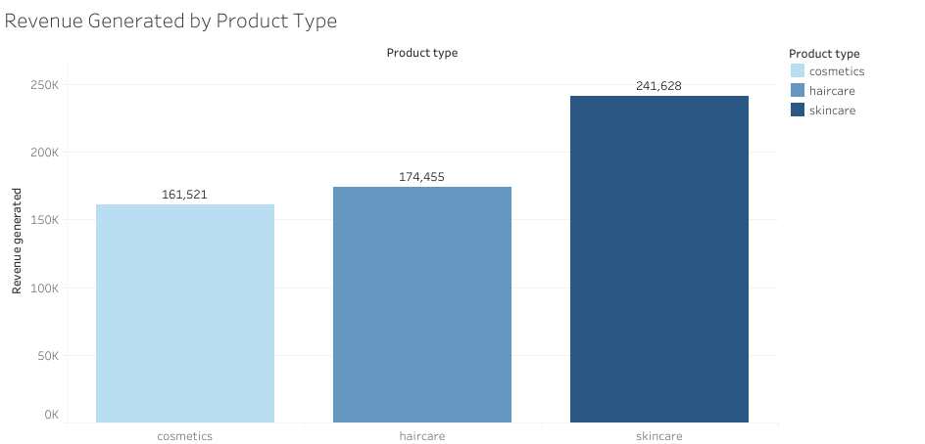
Which product type generates the highest revenue?
Skincare generates the highest revenue by a significant margin, followed by haircare and cosmetics respectively.

Slide 9
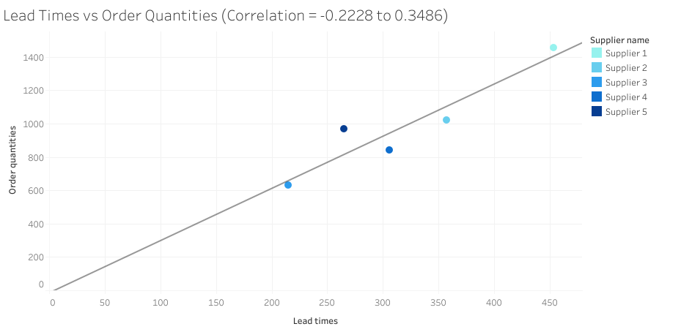
Are there any significant correlations between Lead times and Order quantities?
There are no significant correlations between lead times and order quantities, with a 0.105 coefficient of correlation.
There is a slight correlation up to o.35 when we take the supplier into account.

Slide 10
How do Shipping costs vary by Shipping carrier and Location?

Slide 11
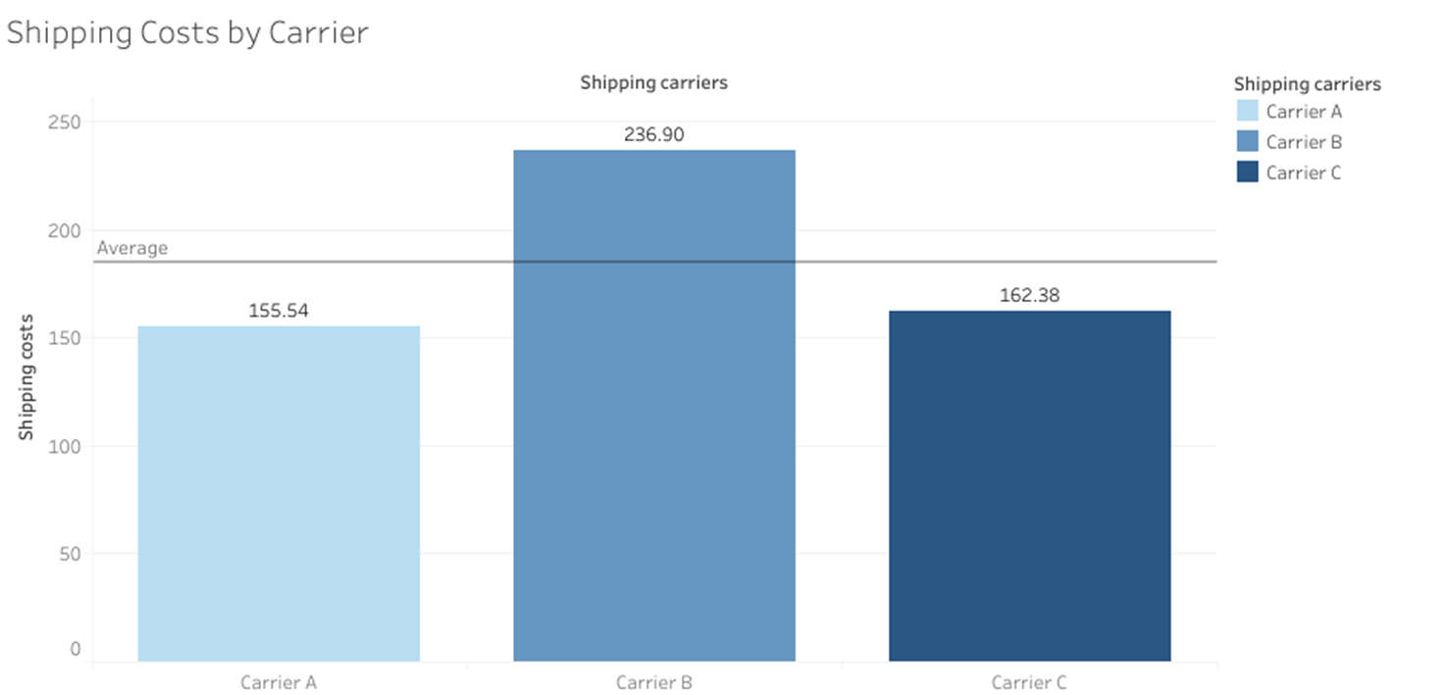
Shipping costs by Carrier
The shipping costs are significantly higher for Carrier B (236.90), whereas it remains similar for Carrier A and C.
The average cost of shipping by carrier is 184.94.

Slide 12
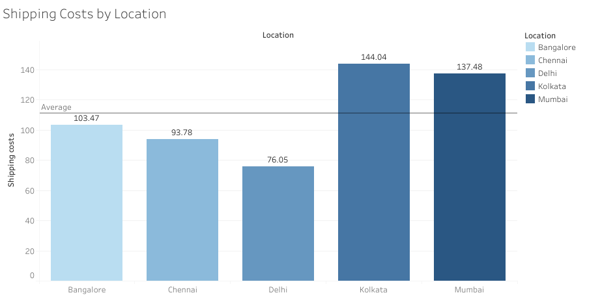
Shipping costs by location
The shipping costs are highest in Kolkata(144.04) and Mumbai by a large margin. Whereas they are lower in Bangalore, Chennai, and Delhi, with Delhi being the least(76.05).
The average shipping costs by location is 110.96.

Slide 13
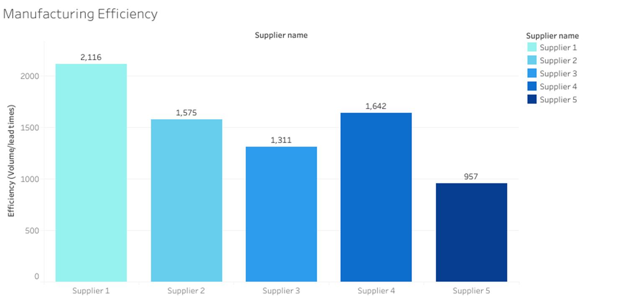
Which suppliers have the most efficient manufacturing processes based on Manufacturing lead time and Production volumes?
Supplier 1 has the highest manufacturing efficiency based on Production volumes and Manufacturing lead times.
Manufacturing Efficiency = Production Volume/Manufacturing lead times

Slide 14
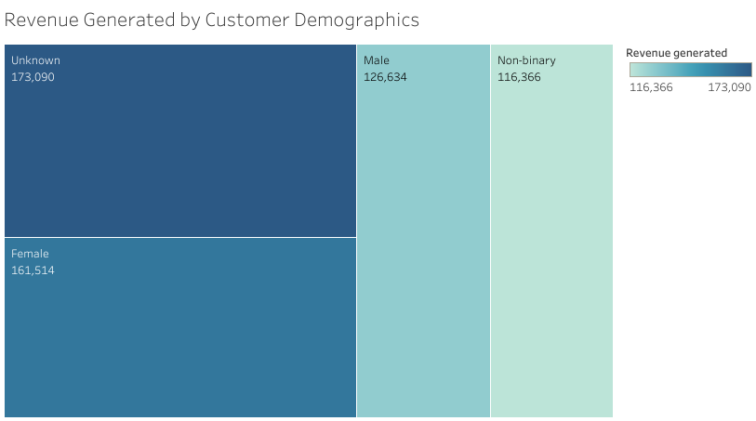
What demographic group contributes the most to sales?
The demographic group that contributes the most to sales is the Unknown group, which is probably due to the fact that data is incomplete.
Therefore, the female demographic contributes the most to sales.

Slide 15
Conclusion
Skincare product type generates the highest revenue by a large margin when compared to haircare and cosmetics.
There are no significant correlation between lead times and order quantities.
Shipping costs are higher when the shipping location is Kolkata or Mumbai. Similarly, the shipping costs are higher when using Carrier 1 for shipping.
Supplier 1 has the most efficient manufacturing processes while Supplier 5 has the least.
Although the 'Unknown' demographic is currently the largest contributor to sales, this is likely due to missing or inaccurate data. When considering complete data, the female demographic emerges as the primary driver of sales.

Slide 16
THANK YOU

